Slide 1
Chapter 8 Geologic Time

Slide 3
1. H
2. J
3. E
4. B
5. G
6. K
7. D
8. C
9. F
10. A

Slide 4
Field Trip
9:45 at Devils Millhopper
Things to Bring –
Rain Gear
Comfortable Shoes
Bug Spray
Camera
4732 Millhopper Road Gainesville, FL 32653
(352) 955-2008
Florida Museum of Natural History 3215 Hull Road Gainesville, FL 32611-2710
352 846 2000

Slide 5
Devil’s Mill Hopper

Slide 6
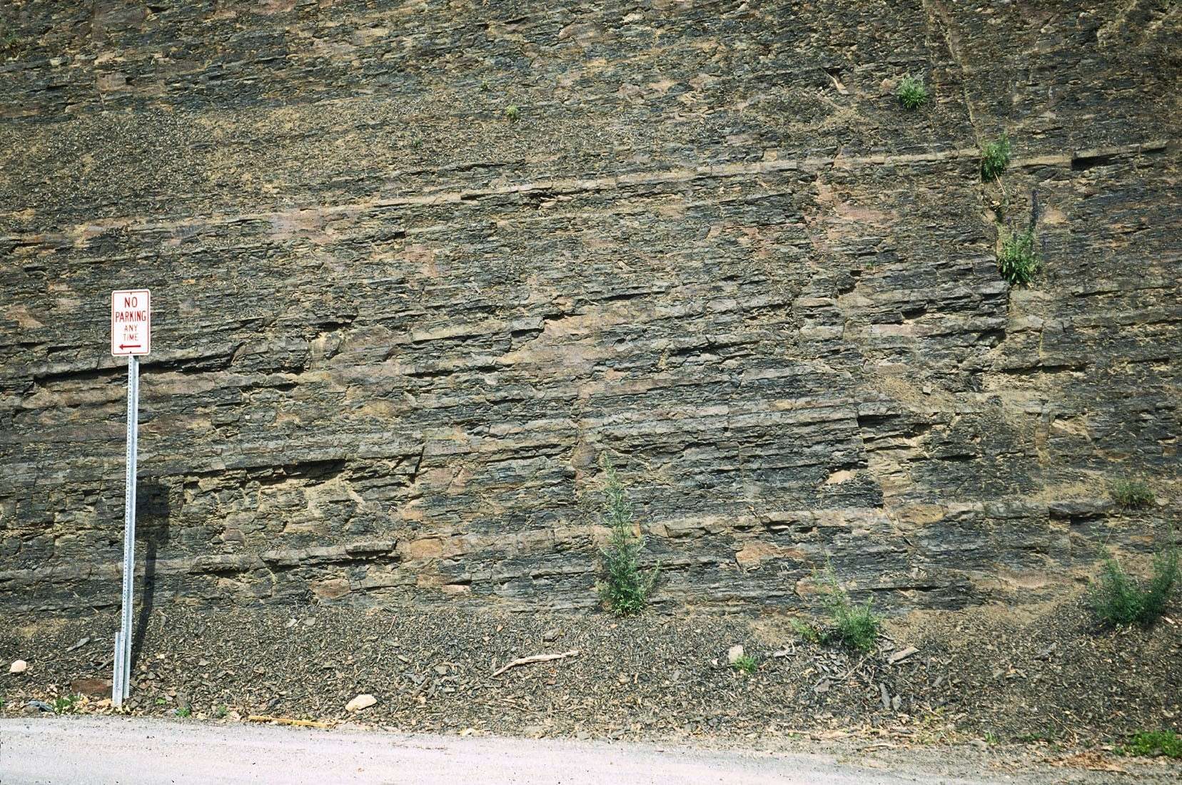
Relative Dating
Law of superposition
Developed by Nicolaus Steno in 1669
In an undeformed sequence of sedimentary rocks (or layered igneous rocks), the oldest rocks are on the bottom

Slide 7
Superposition Is Well Illustrated by the Strata in the Grand Canyon

Slide 8
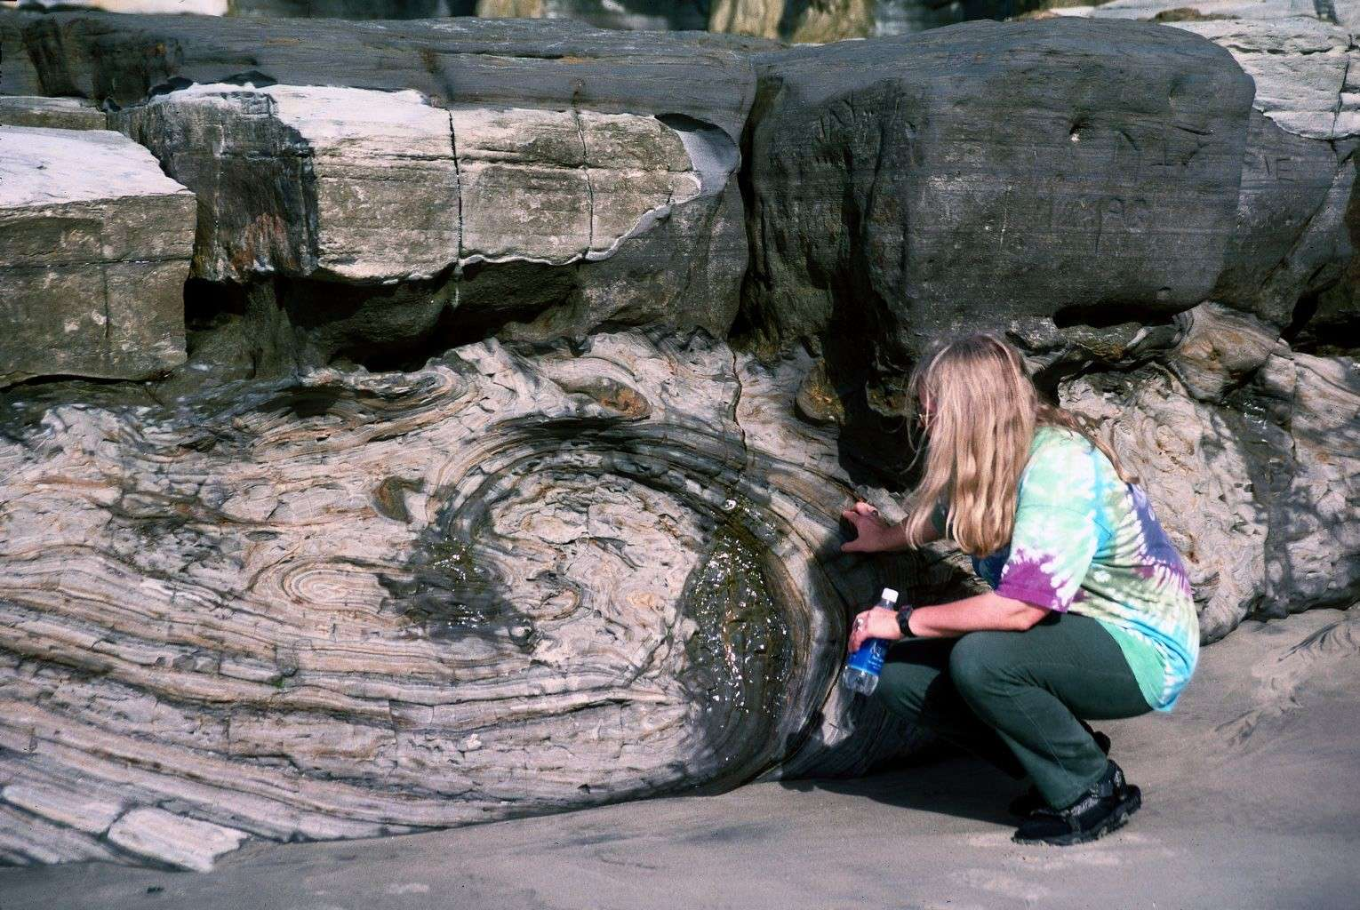
Relative Dating
Principle of original horizontality
Layers of sediment are generally deposited in a horizontal position
Rock layers that are flat have not been disturbed

Slide 9
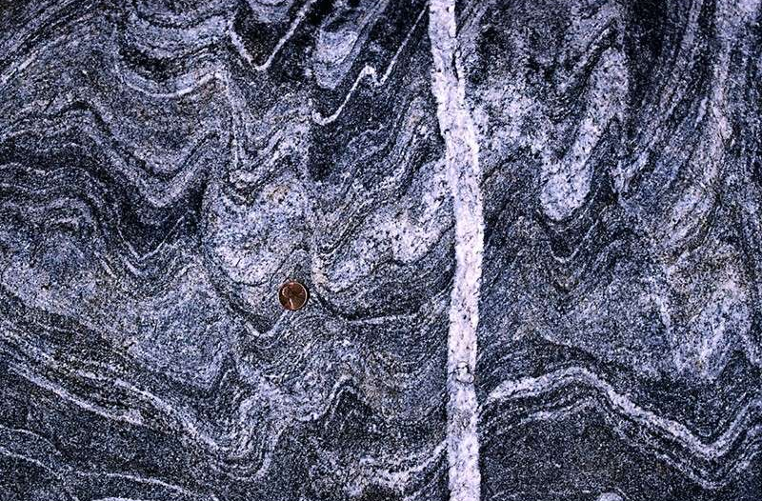
Relative Dating
Principle of cross-cutting relationships
Younger features cut across older features

Slide 10
Cross-Cutting Relationships
Figure 8.4

Slide 11
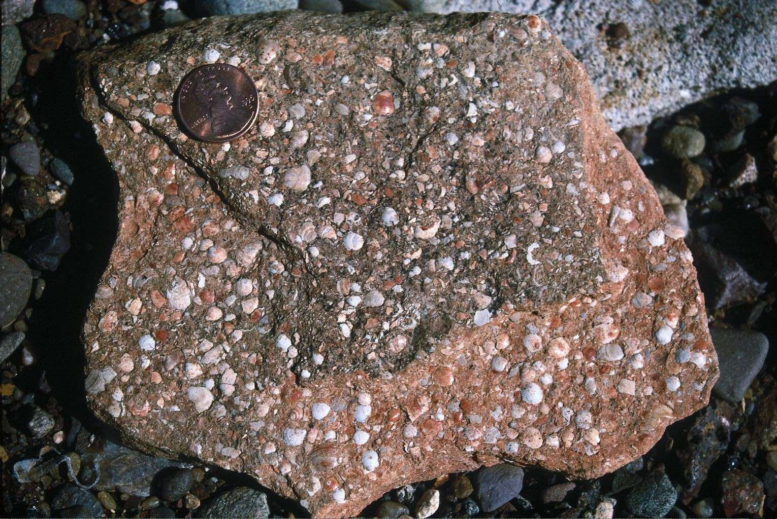
Relative Dating
Inclusions
An inclusion is a piece of rock that is enclosed within another rock
Rock containing the inclusion is younger

Slide 12
Relative Dating
Unconformity
An unconformity is a break in the rock record produced by erosion and/or nondeposition of rock units

Slide 13
Relative Dating
Unconformity
Types of unconformities
Angular unconformity—Tilted rocks are overlain by flat-lying rocks
Disconformity—Strata on either side of the unconformity are parallel
Nonconformity—Metamorphic or igneous rocks in contact with sedimentary strata

Slide 14
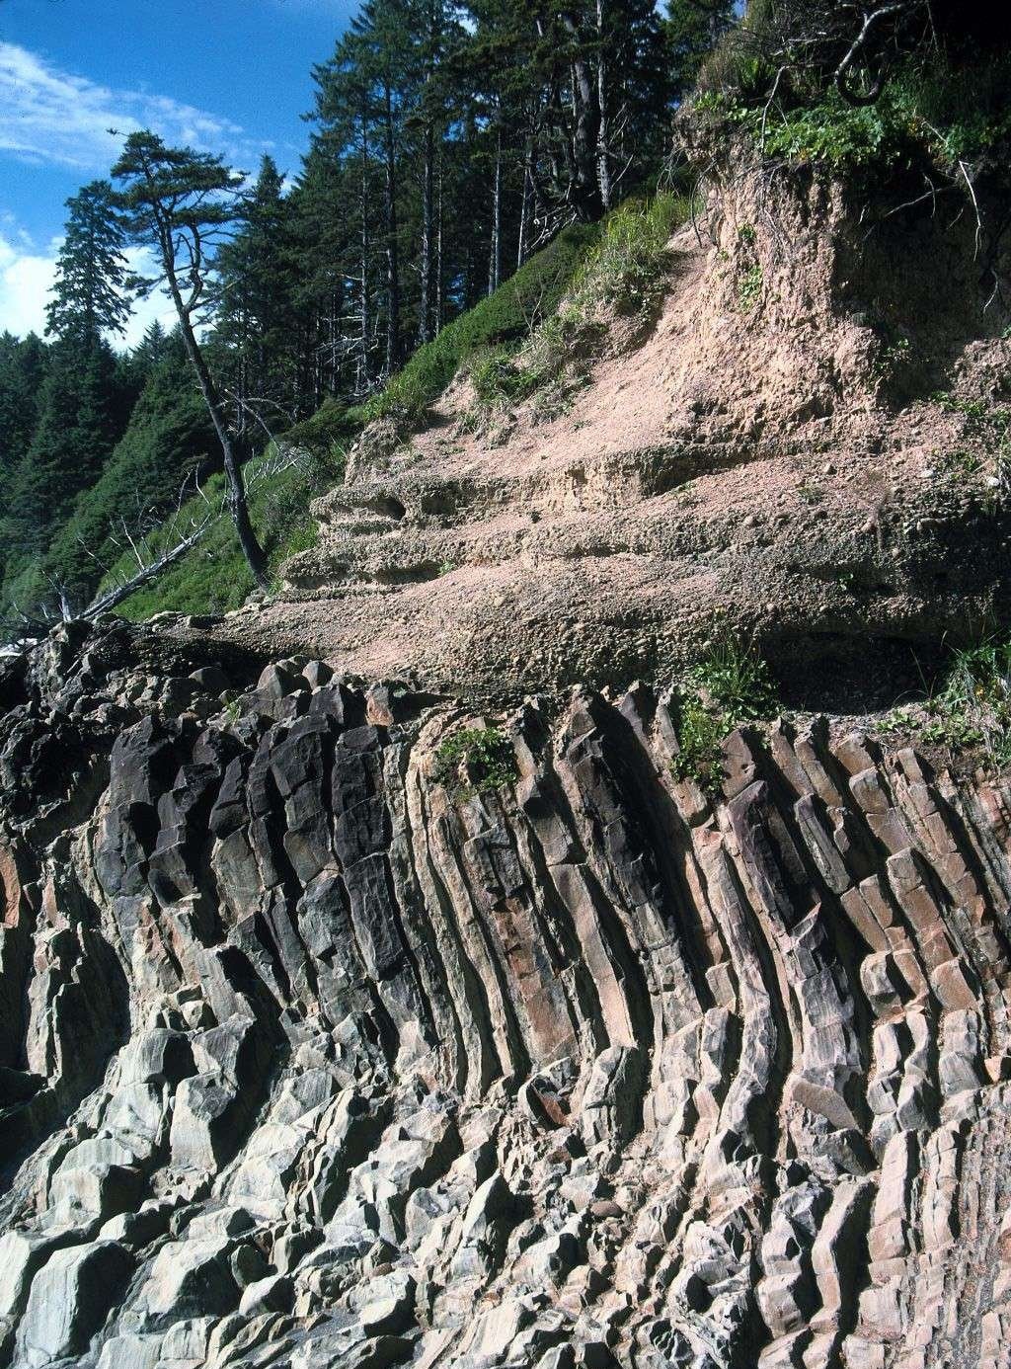
Relative Dating - Angular Unconformity

Slide 15
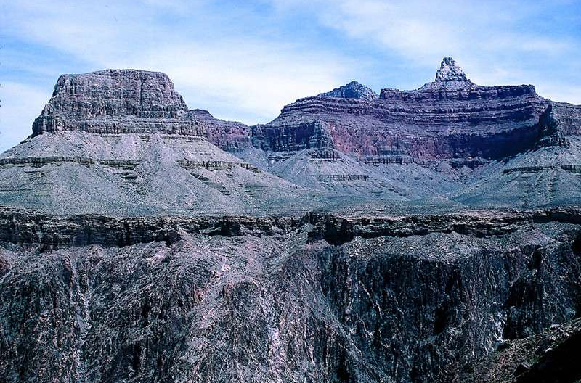
Relative Dating - Nonconformity

Slide 16
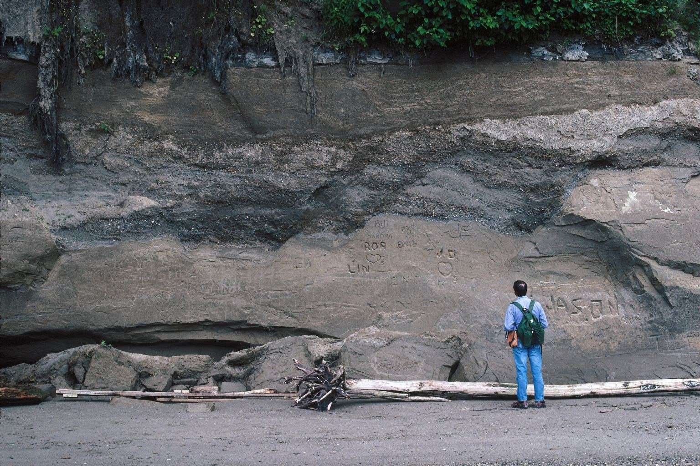
Relative Dating – Disconformities

Slide 17
Dating with Radioactivity
Parent —An unstable radioactive isotope
Daughter product—The isotopes resulting from the decay of a parent
Half-life—The time required for one-half of the radioactive nuclei in a sample to decay

Slide 18
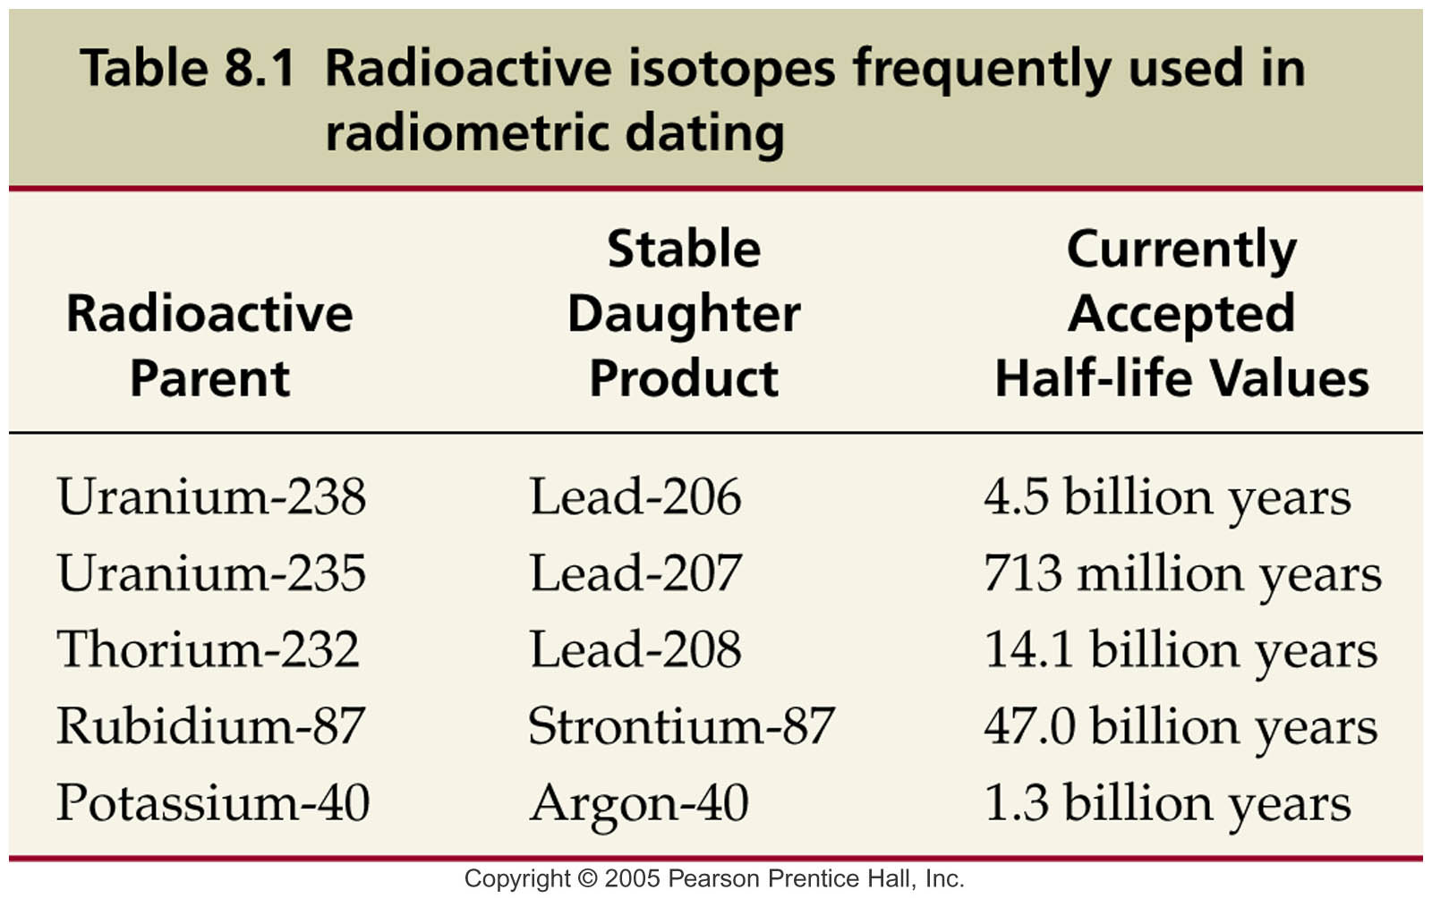
Dating with Radioactivity

Slide 19
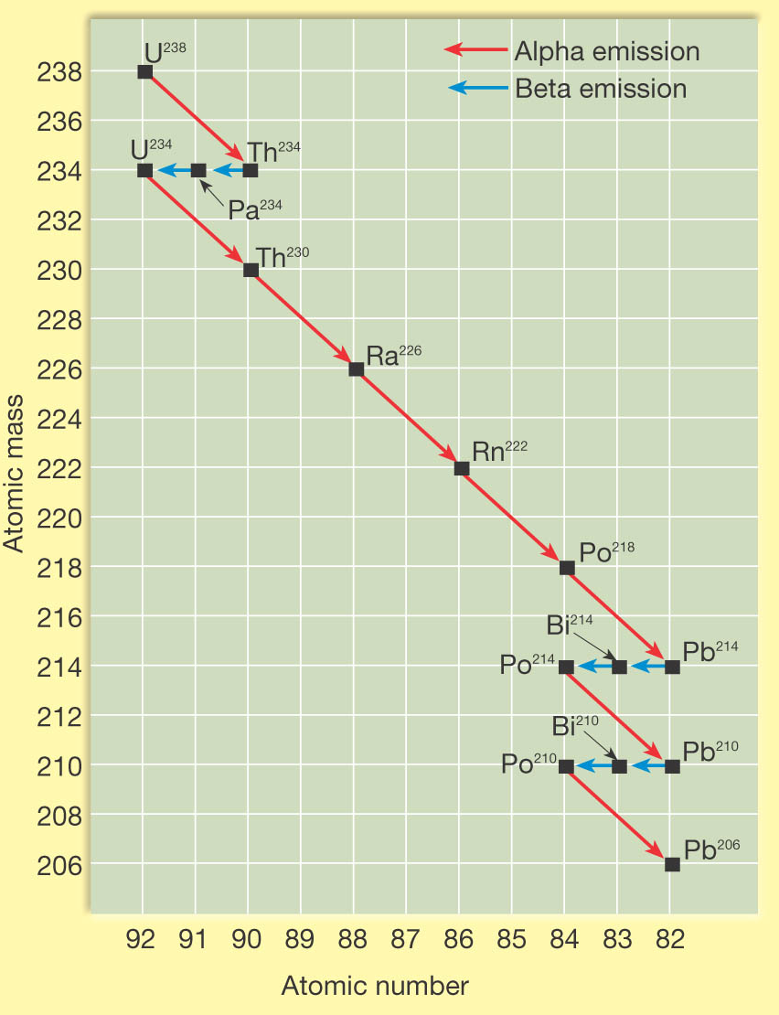
Dating with Radioactivity

Slide 20
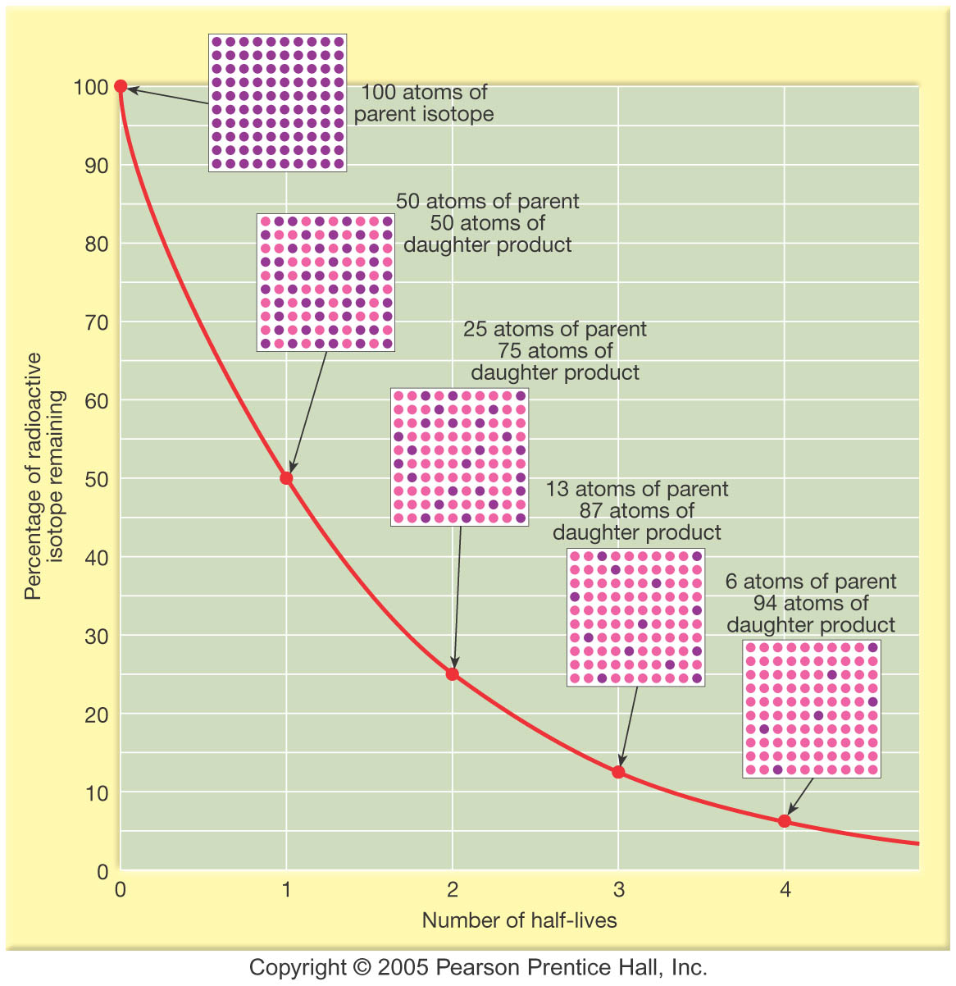
Dating with Radioactivity

Slide 21
Dating with Radioactivity
Radiometric dating
Principle of radioactive dating
The percentage of radioactive atoms that decay during one half-life is always the same (50 percent)
However, the actual number of atoms that decay continually decreases
Comparing the ratio of parent to daughter yields the age of the sample
Decay is not affected by external forces

Slide 22
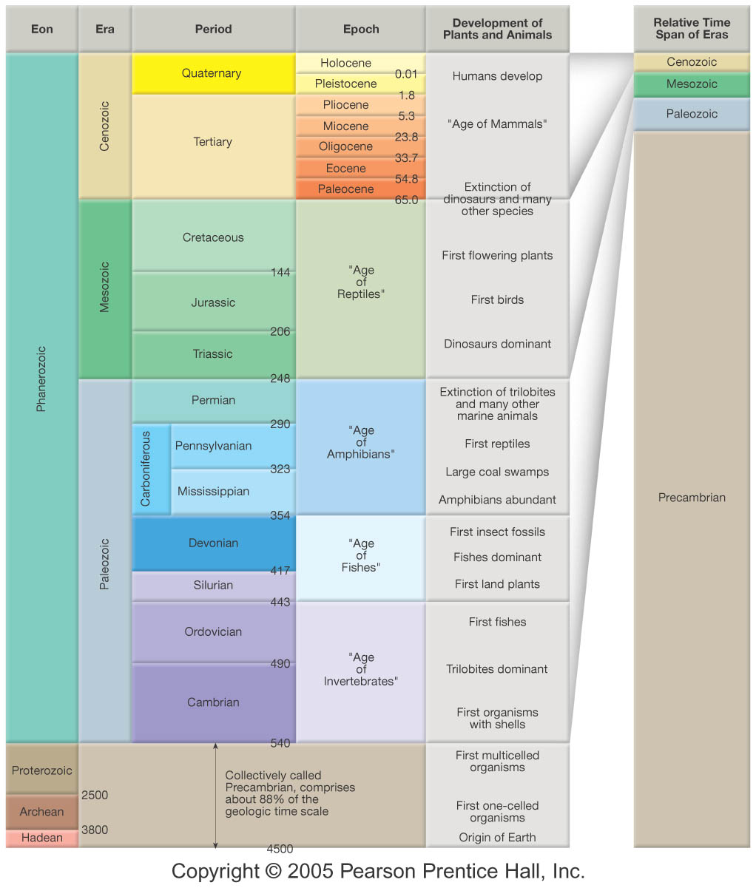
The Geologic Time Scale

Slide 23
The Geologic Time Scale
Structure of the geologic time scale
Names of the eons
Phanerozoic (“visible life”)—The most recent eon, began about 540 million years ago
Proterozoic
Archean
Hadean—The oldest eon

Slide 24
The Geologic Time Scale
Structure of the geologic time scale
Era—Subdivision of an eon
Eras of the Phanerozoic eon
Cenozoic (“recent life”)
Mesozoic (“middle life”)
Paleozoic (“ancient life”)
Eras are subdivided into periods
Periods are subdivided into epochs

Slide 25
The Geologic Time Scale
Precambrian time
Nearly 4 billion years prior to the Cambrian period
Not divided into smaller time units because the events of Precambrian history are not known in great enough detail
First abundant fossil evidence does not appear until the beginning of the Cambrian

Slide 26
Fossils: Evidence of Past Life
Fossil = traces or remains of prehistoric life now preserved in rock
Fossils are generally found in sediment or sedimentary rock (rarely in metamorphic and never in igneous rock)
Paleontology = study of fossils

Slide 27
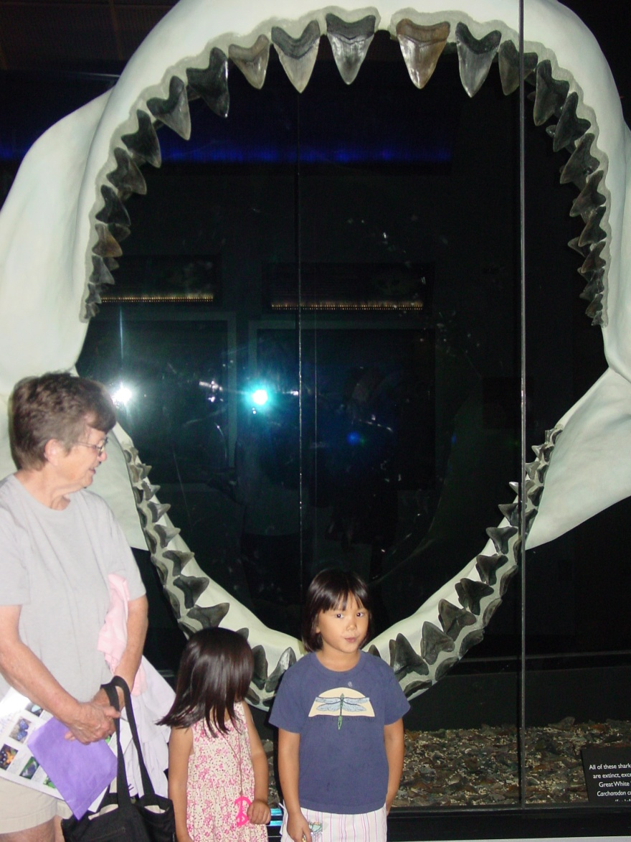
Fossils: Evidence of Past Life
Conditions favoring preservation
Rapid burial
Possession of hard parts (skeleton, shell, etc.)

Slide 28
Chapter 9 Oceans: The Last Frontier

Slide 29
The Vast World Ocean
Earth is often referred to as the blue planet
Seventy-one percent of Earth’s surface is represented by oceans and marginal seas
Continents and islands comprise the remaining 29%

Slide 30
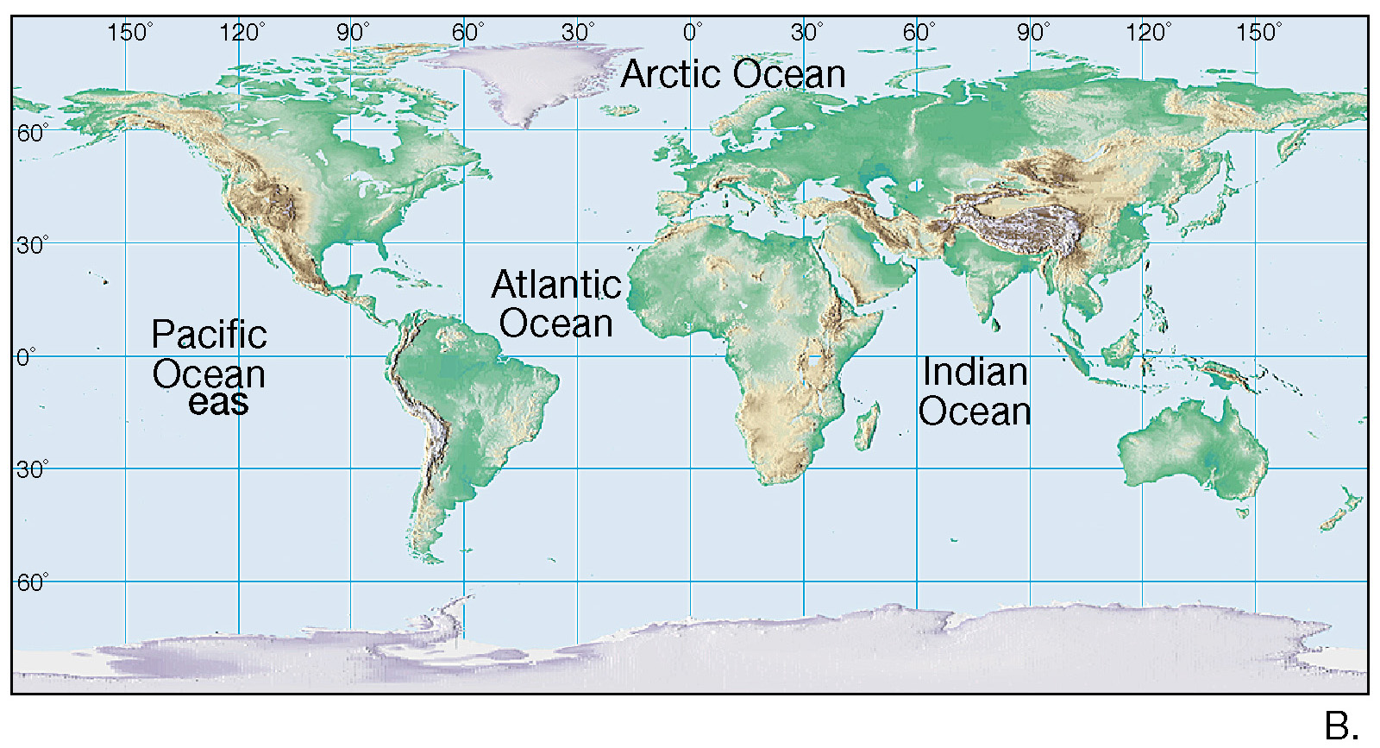
The Oceans of Earth

Slide 31
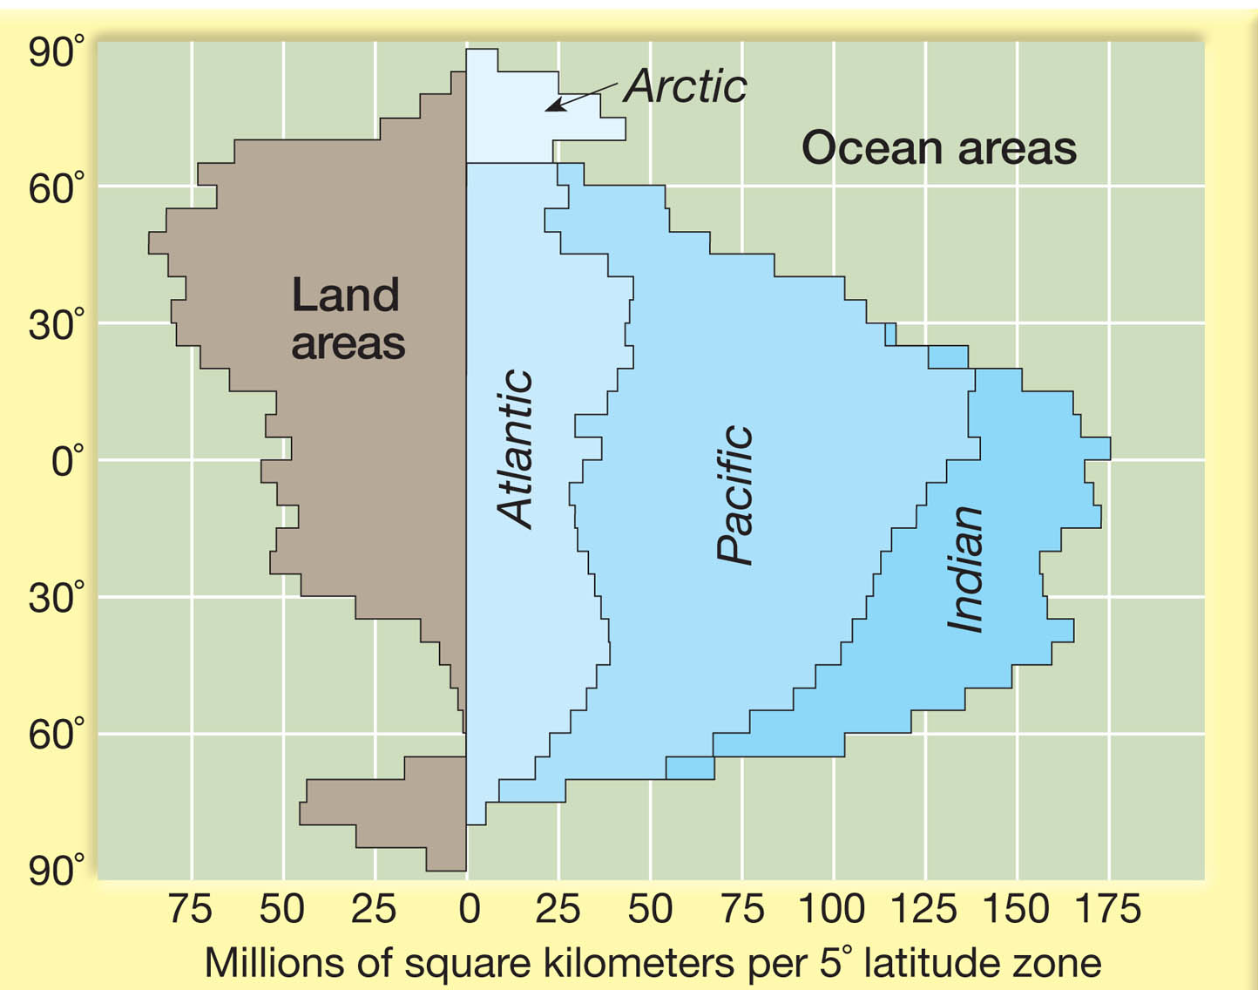
The Oceans of Earth

Slide 32
The Vast World Ocean
Four main ocean basins
Pacific Ocean—The largest and has the greatest depth
Atlantic Ocean—About half the size of the Pacific and not quite as deep
Indian Ocean—Slightly smaller than the Atlantic, largely a Southern Hemisphere body
Arctic Ocean—About 7 percent the size of the Pacific

Slide 33
The Vast World Ocean
Northern Hemisphere is called the land hemisphere, and the Southern Hemisphere the water hemisphere

Slide 34
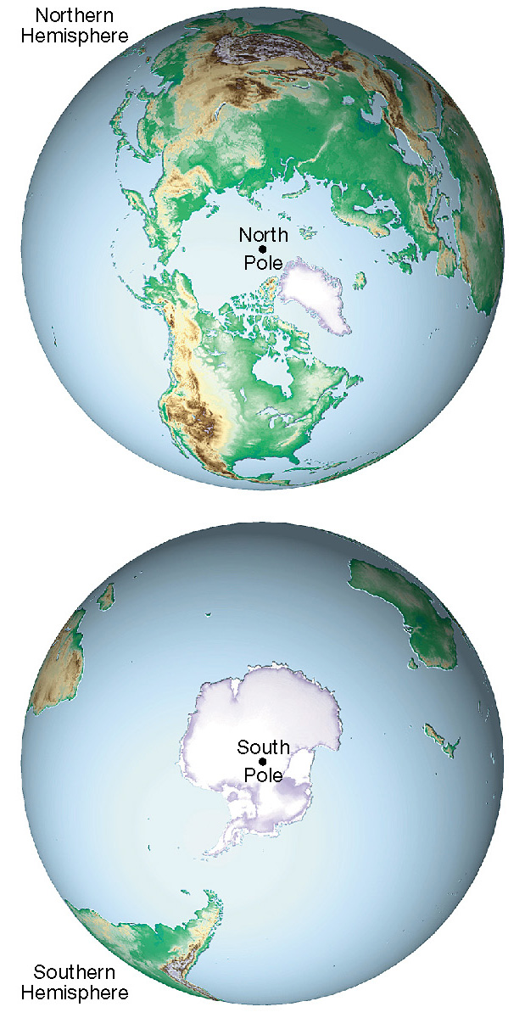
Views of the Northern and Southern Hemispheres

Slide 35
Origin of Seawater
Comets
Volcanoes

Slide 36
Composition of Seawater
Salinity
Salinity is the total amount of solid material dissolved in water
Typically expressed as a %
Dissolved substances in seawater are small numbers and therefore expressed in parts per thousand
Most of the salt in seawater is sodium chloride (table salt)

Slide 37
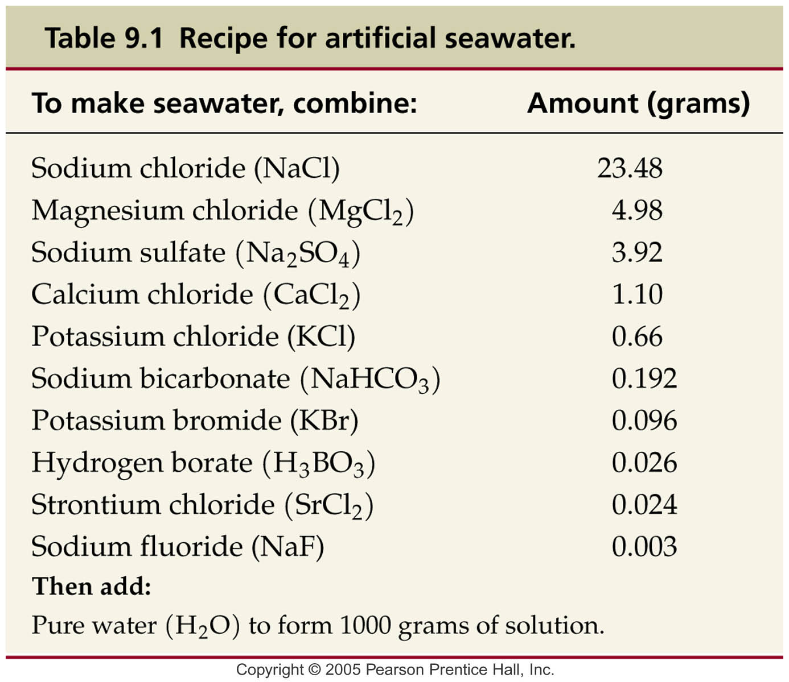

Slide 38
Dissolved Components in Seawater

Slide 39
Composition of Seawater
Salinity
Sources of sea salts
Chemical weathering of rocks on continents is one source
Second major source is Earth’s interior through volcanic eruptions
Process called outgassing
Composition of seawater has been relatively stable for millions of years
Material is removed just as rapidly as it is added

Slide 40
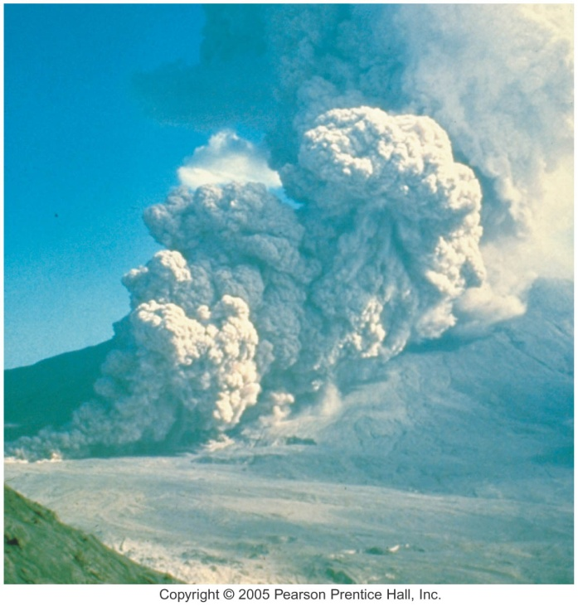
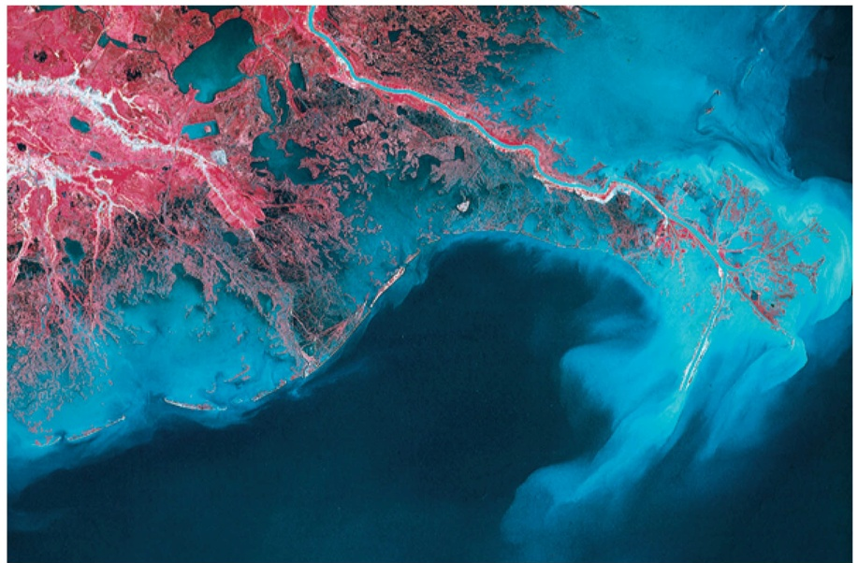
Composition of Seawater
Salinity
Sources of sea salts
Chemical weathering of rocks on continents is one source
Second major source is Earth’s interior through volcanic eruptions
Process called outgassing

Slide 41
Composition of Seawater
Salinity
Processes affecting seawater salinity
Primarily due to changes in the water content of the solution
These include the addition of fresh water due to precipitation, runoff, icebergs melting, and sea-ice melting
The removal of fresh water by evaporation and the formation of sea ice also affect salinity

Slide 42
Precipitation

Slide 43
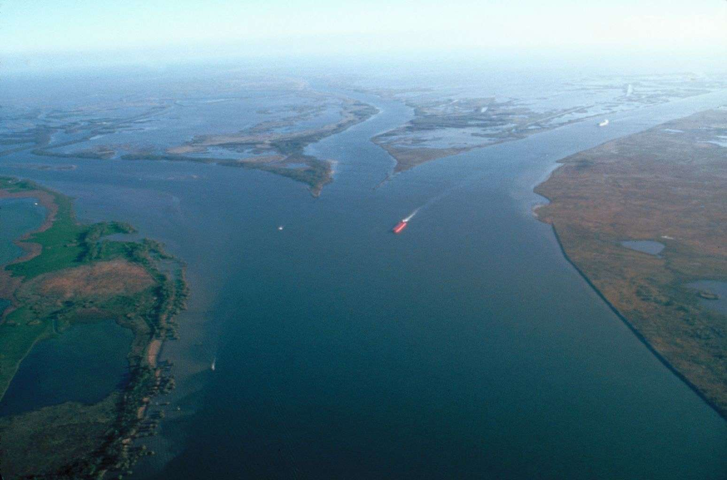
Runoff

Slide 44
Mixing

Slide 45
Mixing

Slide 46
The Ocean’s Layered Structure
Temperature and salinity change with depth in the oceans
A three-layered structure exists in the open ocean
Shallow surface mixed zone
Transition zone
Deep zone
A layer of rapid temperature change below the zone or mixing is known as the thermocline

Slide 47
The Oceans Layered Structure

Slide 48
The Ocean’s Layered Structure
Temperature and salinity change with depth in the oceans
Salinity variations with depth correspond to the general three-layered structure described for temperature
A zone of rapidly changing salinity, called the halocline, corresponds to the thermocline

Slide 49
The Sea Floor
Bathymetry—Measurement of ocean depths and the charting of the shape or topography of the ocean floor
Echo sounder (also called sonar)
Invented in the 1920s
Primary instrument for measuring depth
Reflects sound from ocean floor

Slide 50
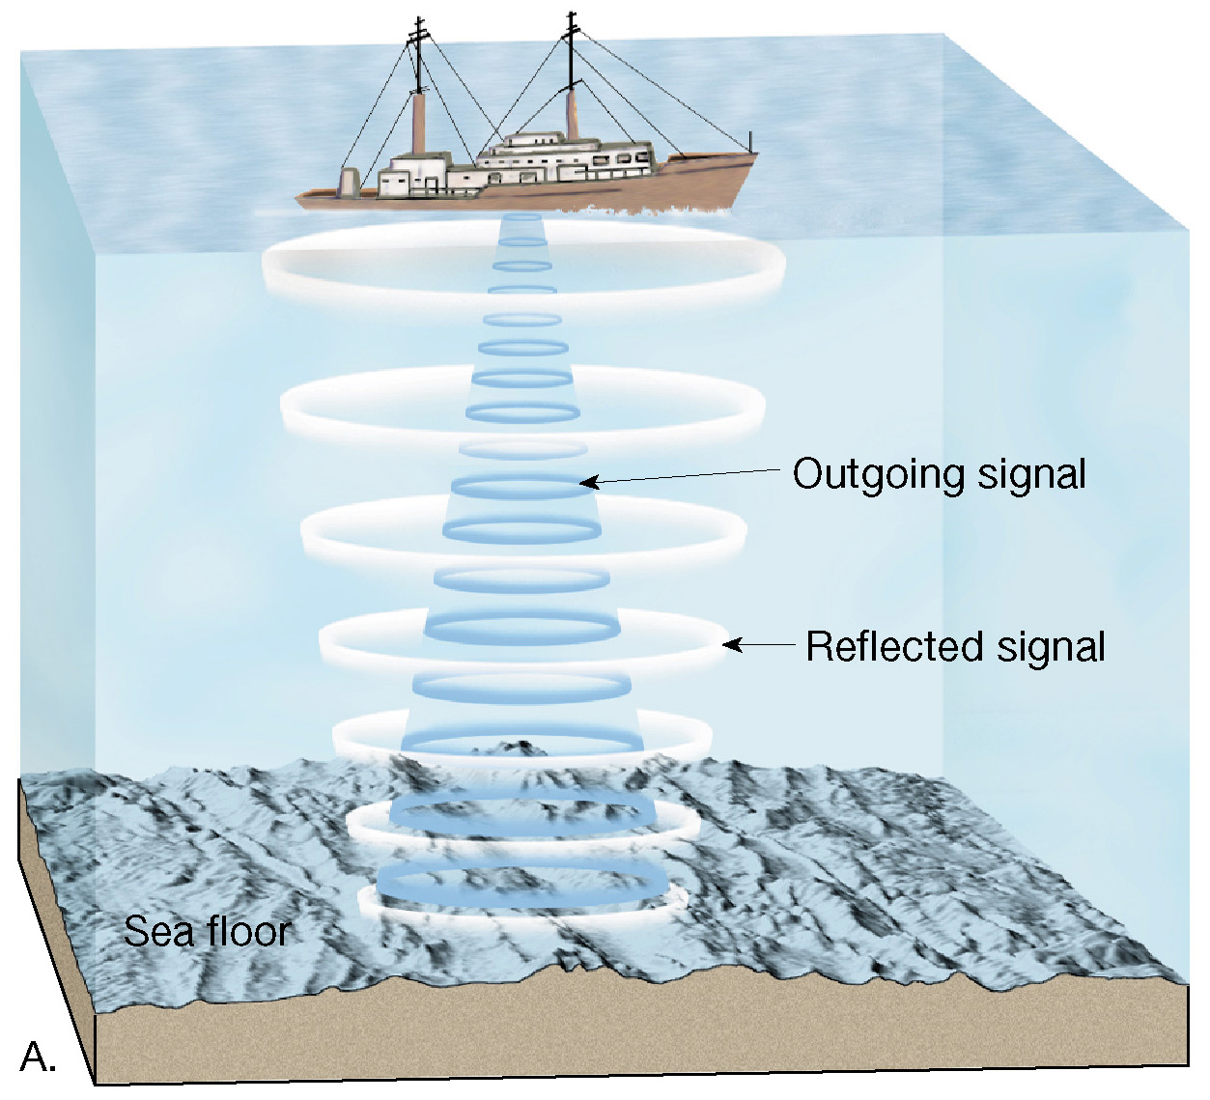
Echo Sounder
Figure 9.6 A

Slide 51
Mapping the Ocean Floor
Multibeam sonar
Employs and array of sound sources and listening devices
Obtains a profile of a narrow strip of seafloor
Measuring the shape of the ocean surface from space
Employs satellites equipped with radar altimeters

Slide 52
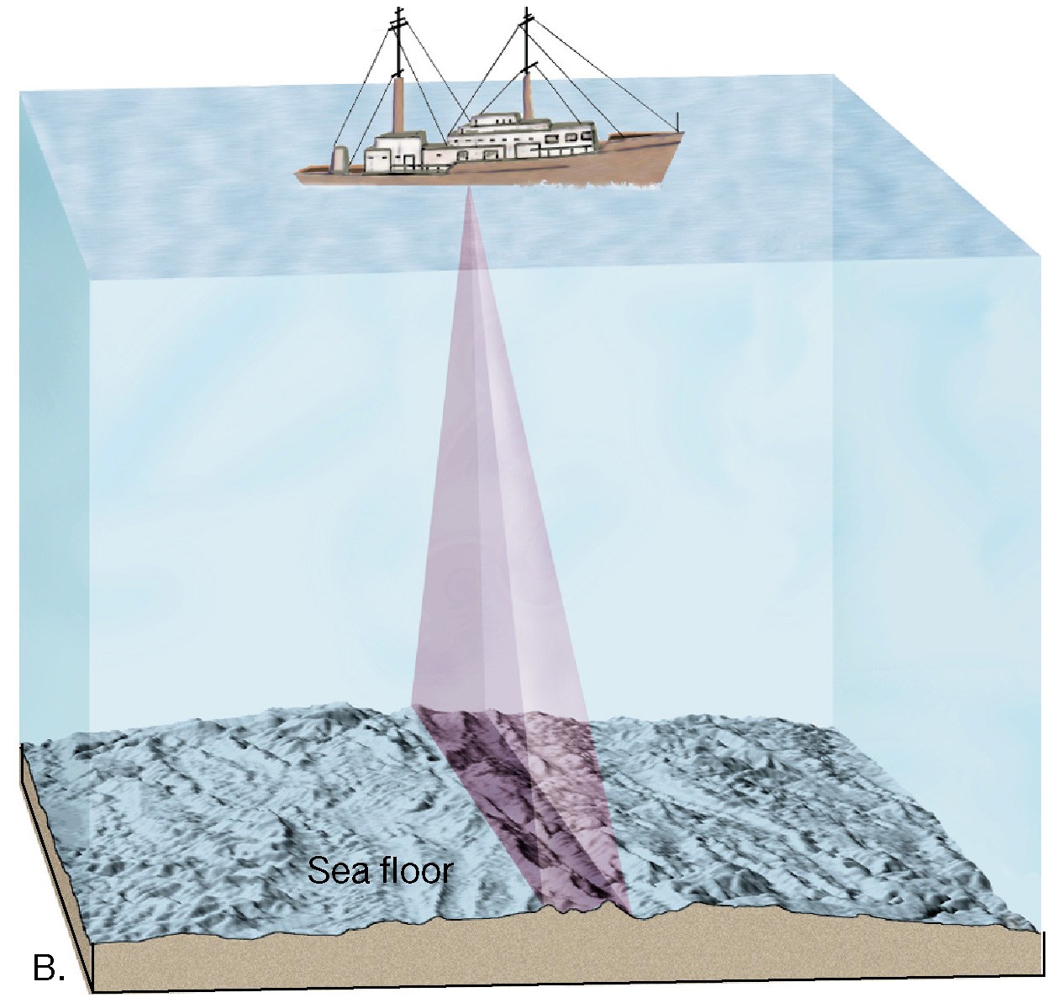
Multibeam Sonar
Figure 9.6 B

Slide 53
Mapping the Ocean Floor
Three major topographic units of the ocean floor
Continental margins
Ocean basin floor
Oceanic (mid-ocean) ridge

Slide 54
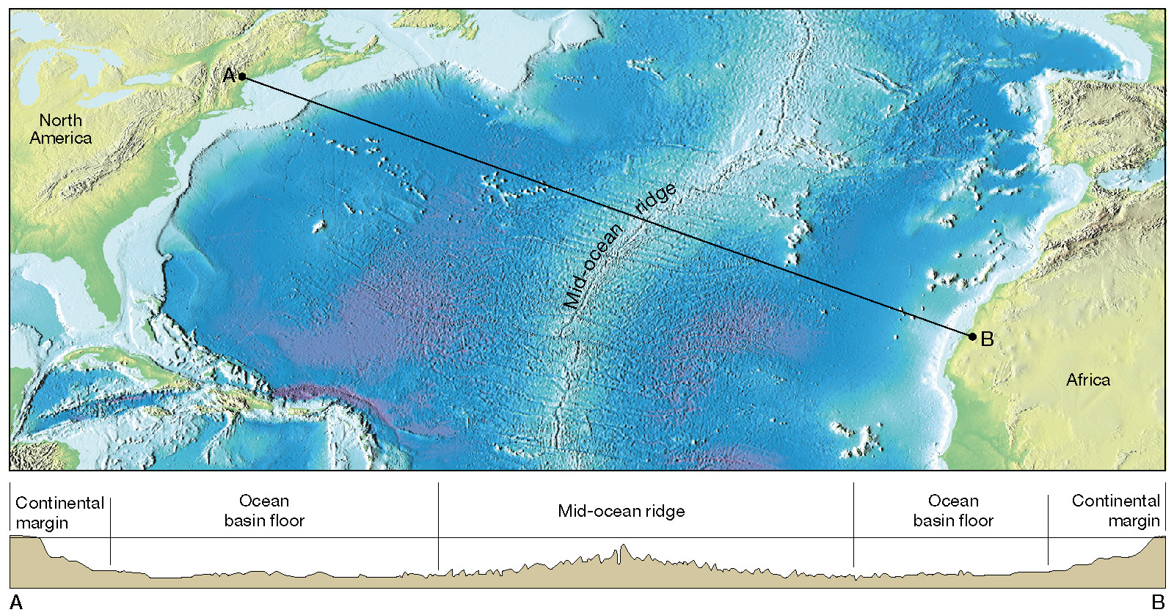
Major Topographic Divisions of the North Atlantic Ocean

Slide 55
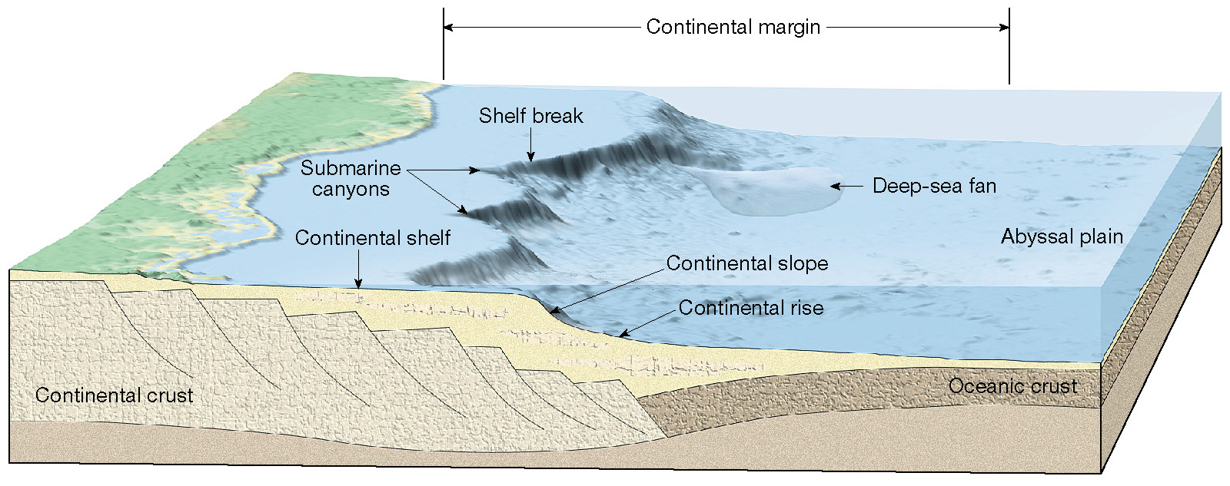
Features of a Continental Margin

Slide 56
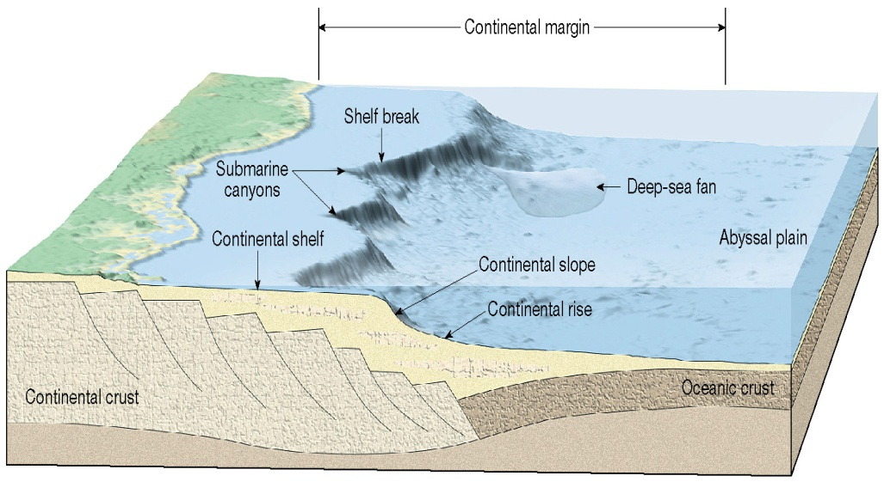
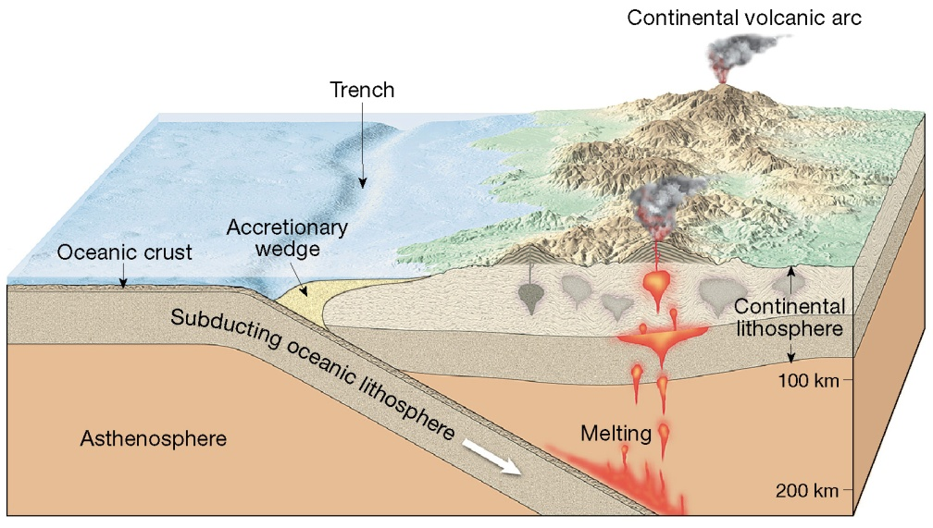
Continental Margins
Passive
Continental Shelf
Continental Slope
Continental Rise
Active
Continental Shelf
Continental Slope
Trench

Slide 57
Continental Margins
Continental shelf
Flooded extension of the continent
Varies greatly in width
Gently sloping
Contains oil and important mineral deposits
Some areas are mantled by extensive glacial deposits
Most consist of thick accumulations of shallow-water sediments

Slide 58
Features of a Passive Continental Margin
Figure 9.10

Slide 59
Continental Margins
Continental slope
Marks the seaward edge of the continental shelf
Relatively steep structure
Boundary between continental crust and oceanic crust

Slide 60
Features of a Passive Continental Margin
Figure 9.10

Slide 61
Continental Margins
Continental rise
Continental slope merges into a more gradual incline—The continental rise
At the base of the continental slope turbidity currents that follow submarine canyons deposit sediment that forms deep-sea fans
Found in regions where trenches are absent

Slide 62
Features of a Passive Continental Margin
Figure 9.10

Slide 63
Continental Margins
Submarine canyons and turbidity currents
Submarine canyons
Deep, steep-sided valleys cut into the continental slope
Some are seaward extensions of river valleys
Most appear to have been eroded by turbidity currents

Slide 64
Features of a Passive Continental Margin

Slide 65
Continental Margins
Submarine canyons and turbidity currents
Turbidity currents
Downslope movements of dense, sediment-laden water
Deposits are called turbidites

Slide 66
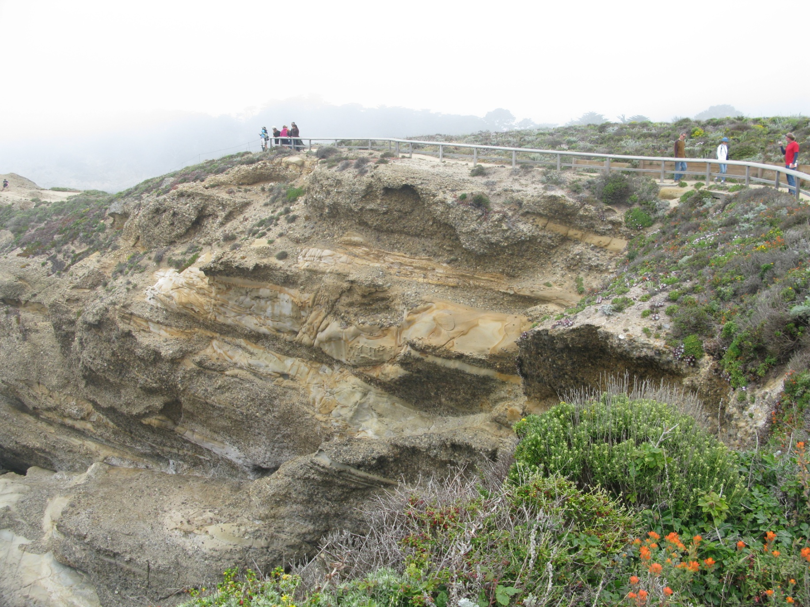
Turbidity currents – large scale

Slide 67
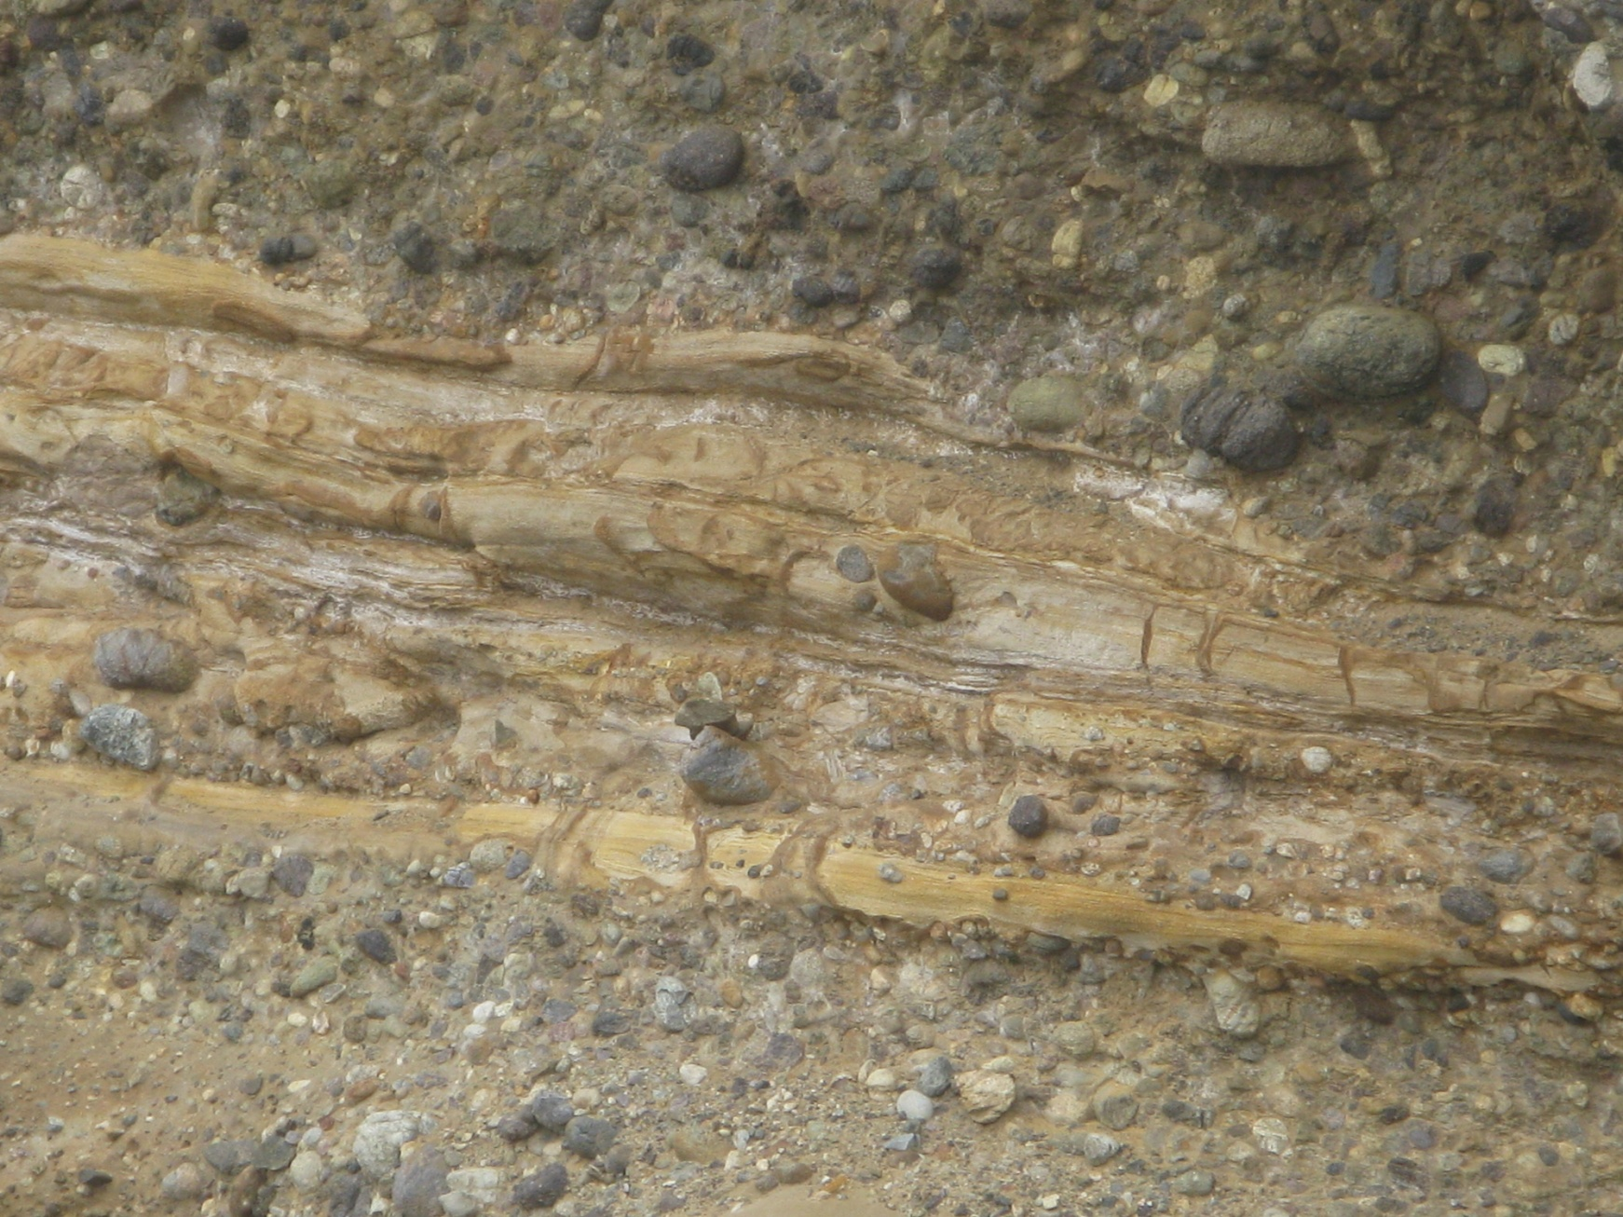
Turbidity currents- small scale

Slide 68
Continental Margins
Active continental margins
Continental slope descends abruptly into a deep-ocean trench
Located primarily around the Pacific Ocean
Accumulations of deformed sediment and scraps of ocean crust form accretionary wedges
Some subduction zones have little or no accumulation of sediments

Slide 69
An Active Continental Margin
Figure 9.11

Slide 70
Deep-Ocean Basin
Deep-ocean trenches
Long, relatively narrow features
Deepest parts of ocean
Most are located in the Pacific Ocean
Sites where moving lithospheric plates plunge into the mantle
Associated with volcanic activity
Volcanic islands arcs
Continental volcanic arcs

Slide 71
Deep-Ocean Basin
Abyssal plains
Likely the most level places on Earth
Sites of thick accumulations of sediment
Found in all oceans

Slide 72
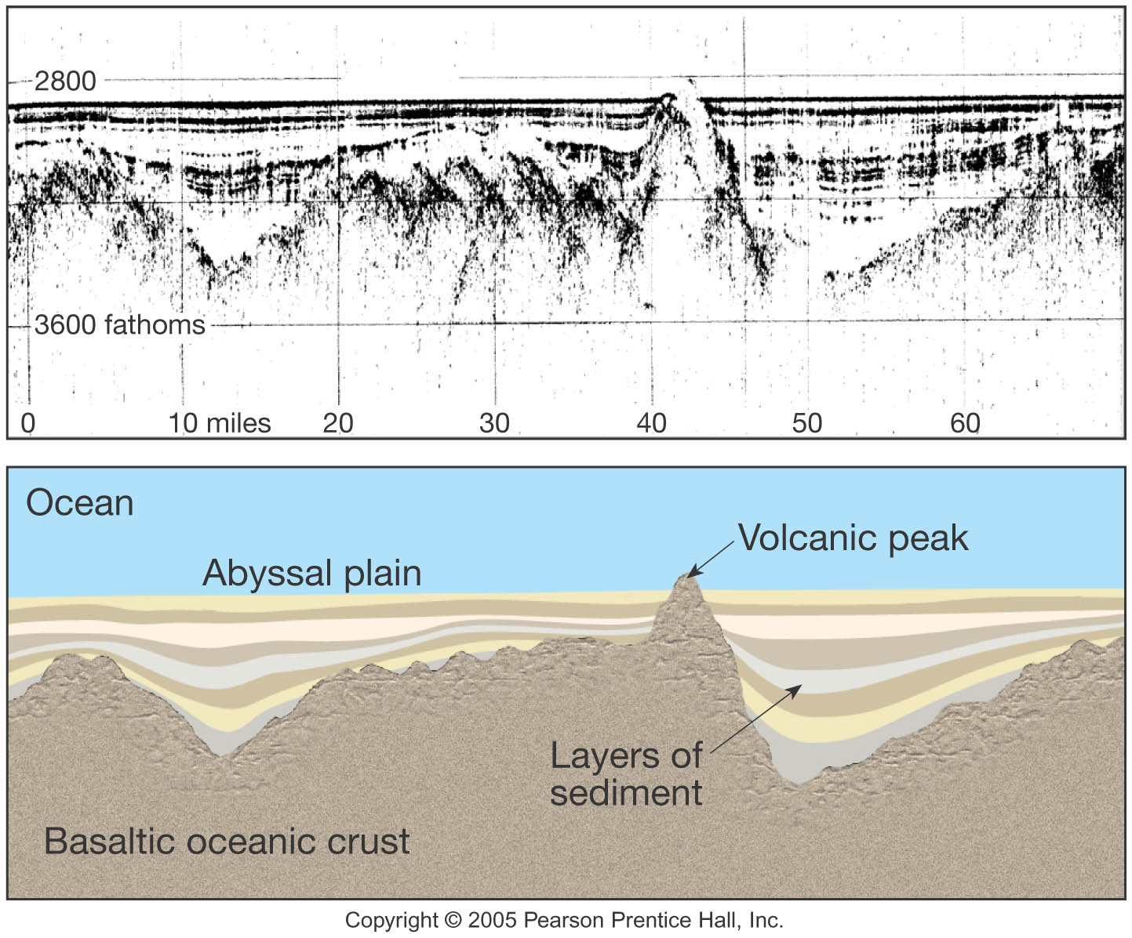
Abyssal Plains

Slide 73
Abyssal Plains

Slide 74
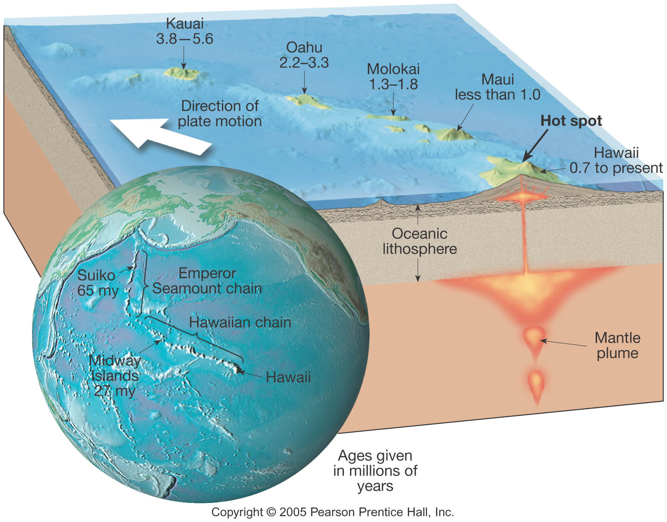
Deep-Ocean Basin
Seamounts and guyots
Isolated volcanic peaks
Many form near oceanic ridges

Slide 75
Deep-Ocean Basin
Mid-ocean ridge
Characterized by
An elevated position
Extensive faulting
Numerous volcanic structures that have developed on newly formed crust

Slide 76
Deep-Ocean Basin
Mid-ocean ridge
Interconnected ridge system is the longest topographic feature on Earth’s surface
Over 70,000 kilometers (43,000 miles) in length
Twenty-three percent of Earth’s surface
Winds through all major oceans
Along the axis of some segments are deep downfaulted structures called rift valleys

Slide 77
Deep-Ocean Basin

Slide 78
Seafloor Sediments
Ocean floor is mantled with sediment
Sources
Turbidity currents
Sediment that slowly settles to the bottom from above
Thickness varies
Thickest in trenches—Accumulations may approach 10 kilometers

Slide 79
Seafloor Sediments
Thickness varies
Pacific Ocean—About 600 meters or less
Atlantic Ocean—From 500 to 1000 meters thick
Mud is the most common sediment on the deep-ocean floor

Slide 80
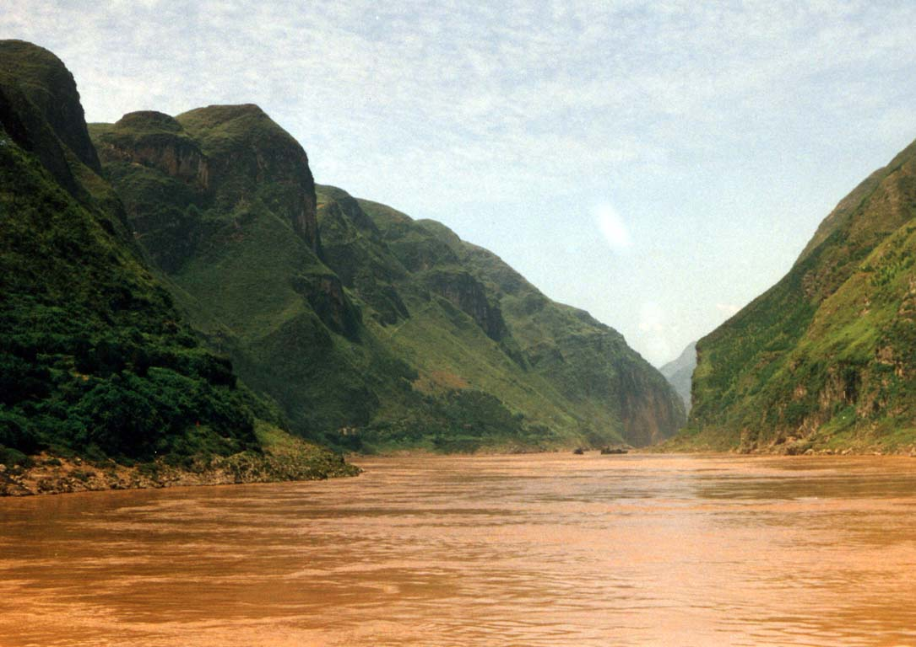
Seafloor Sediments
Types of seafloor sediments
Terrigenous sediment
Material weathered from continental rocks
Virtually every part of the ocean receives some
Fine particles remain suspended for a long time
Oxidation often produces red and brown colored sediments

Slide 81
Seafloor Sediments
Types of seafloor sediments
Biogenous sediment
Shells and skeletons of marine animals and plants
Most common are calcareous oozes produced from microscopic organisms
Siliceous oozes composed of skeletons of diatoms and radiolarians
Phosphate rich materials derived from the bones, teeth, and scales of fish and other marine organisms

Slide 82
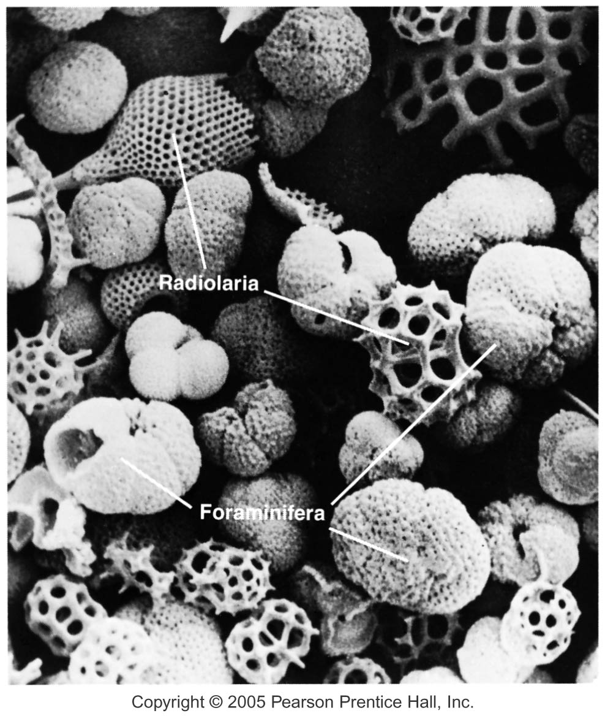
Seafloor Sediments

Slide 83
Seafloor Sediments – Coral Reefs

Slide 84
Seafloor Sediments – Coral Reefs

Slide 85
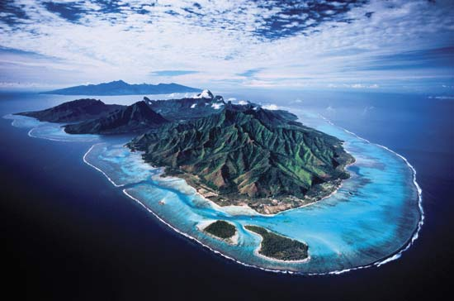
Formation of Atolls

Slide 86
Seafloor Sediments
Types of seafloor sediments
Hydrogenous sediment
Minerals that crystallize directly from seawater
Most common types include
Manganese nodules
Calcium carbonates
Metal sulfides
Evaporites

Slide 87
End of Chapter 9 Next Week Test 3 Chapters 7,8, and 9

